Slide 1
FIFA Player Analysis
David Amankwah
Lydia Jin
Avijeet Kartikay
Nhung Nguyen
Notes:
david

Slide 2
Introduction
Background
Data Set: Kaggle Dataset on the attributes of
FIFA soccer players.
17981 observations with 45 variables
Predict position based on individual players’ attributes
Notes:
David

Slide 3
Literature Review
Methodology
Lao used logistic regression, PCA, and a neural network machine learning algorithms (Lao, 2018)
A different research used Bayesian Networks, Decision Trees, and K-Nearest Neighbor to evaluate which position each individual fits in
K-NN approach
Logistic regression model
Notes:
Nhung

Slide 4
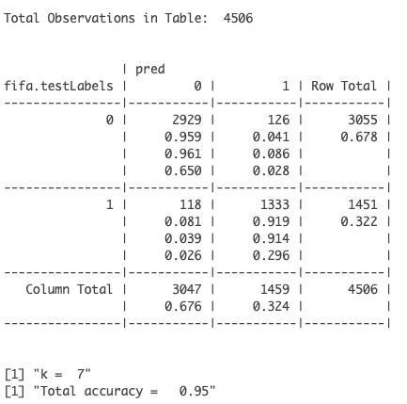
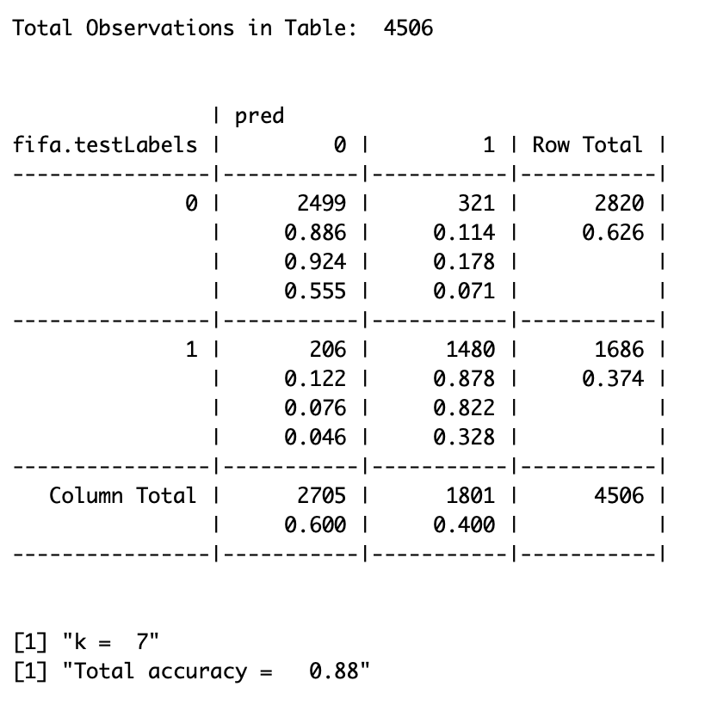
KNN - Defense
KNN - Midfield

Slide 5
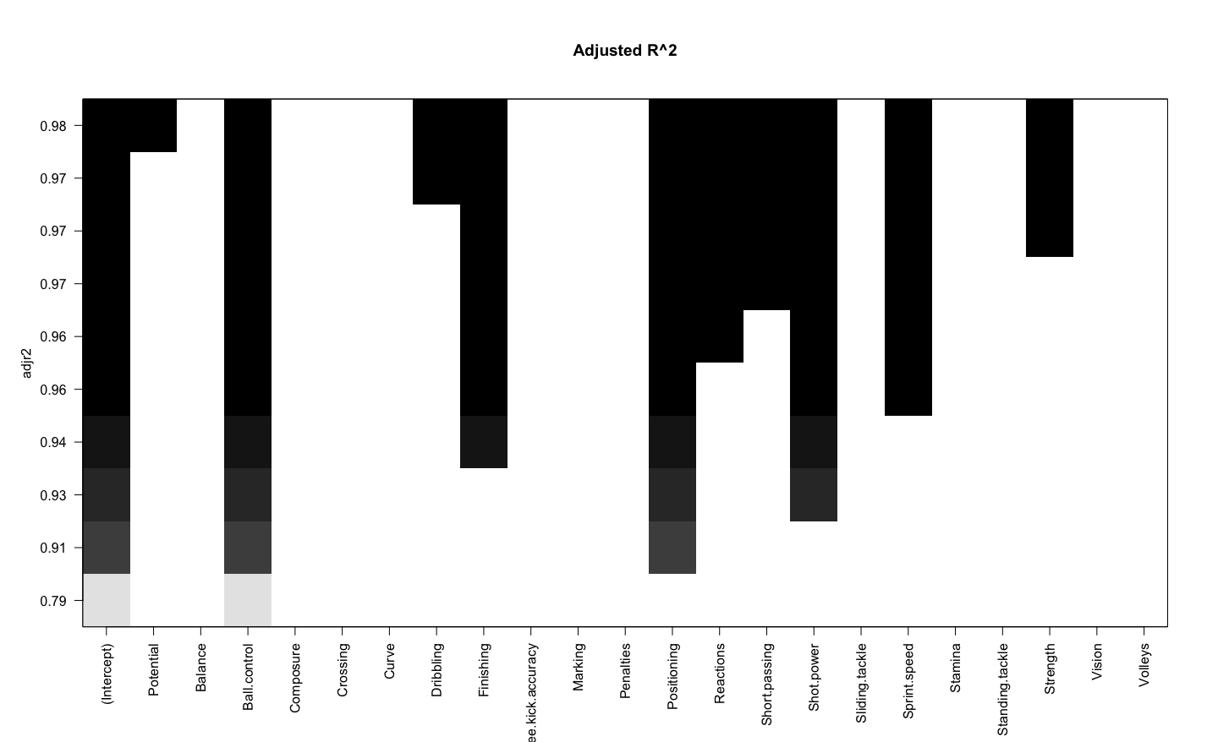
Logistic Regression - Goalkeeper & Attack
Attack:
Subsetting the data
Feature Selection using Overall
Accuracy = 68.16%
Goalkeeper:
Subsetting the data
Feature Selection using Overall
Accuracy = 96.38%
Attack

Slide 6
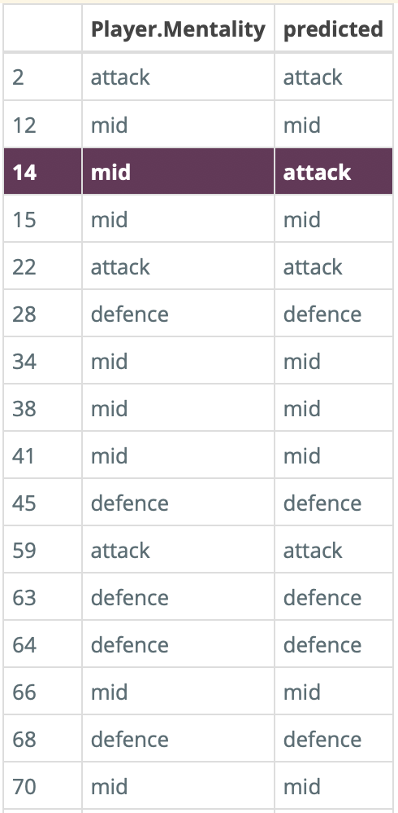
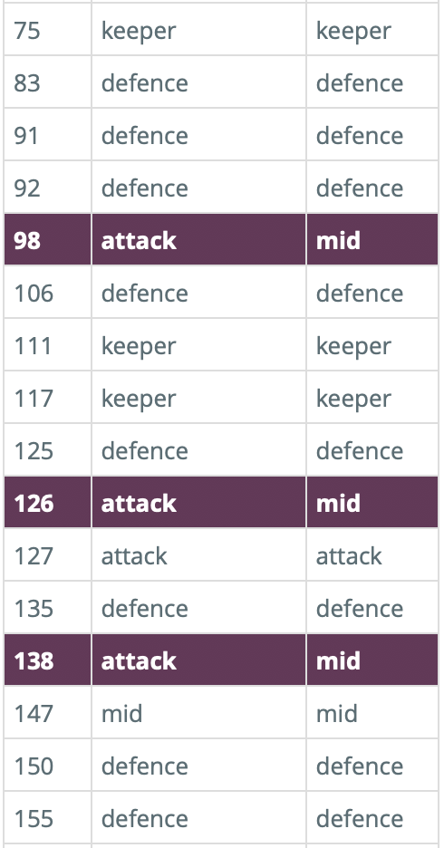
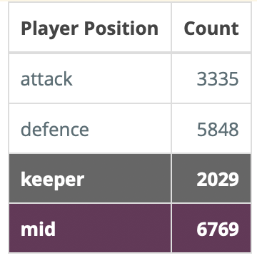
Using Logistic Regression - ONE VS. ALL
Notes:
As it is difficult to make comparisons between the accuracy of logistic regressions predicting individual class labels, and a KNN algorithm that can predict all four class labels at once, we decided to split our data into training and testing datasets, before recursively running logistic regression and feature selection on the player positions. During individual logistic regression, we found that goalkeeper had the highest predictive accuracy, attack and defence had relatively similar accuracy, and midfield had the lowest accuracy.
The table gives us the number of players for each position. We can see that there are much less goalkeepers, while there are a lot of midfielders. Goalkeepers have more specific predicting features, so in our complete logistic model, it makes sense that we start with keeper. Then mid has the greatest number of players, and they share many of the same predicting features with the attack and defence positions, so mid is the least accurate.
The order in which we iteratively performed logistic regression was keeper, defence, attack, and then mid. Our accuracy was found to be 89.04%.
This was a portion of our prediction output using the features from the test dataset, which we place next to the actual player positions for comparison. Just from the first 32 rows, we can see that the incorrect predictions are all between mid and attack positions.

Slide 7
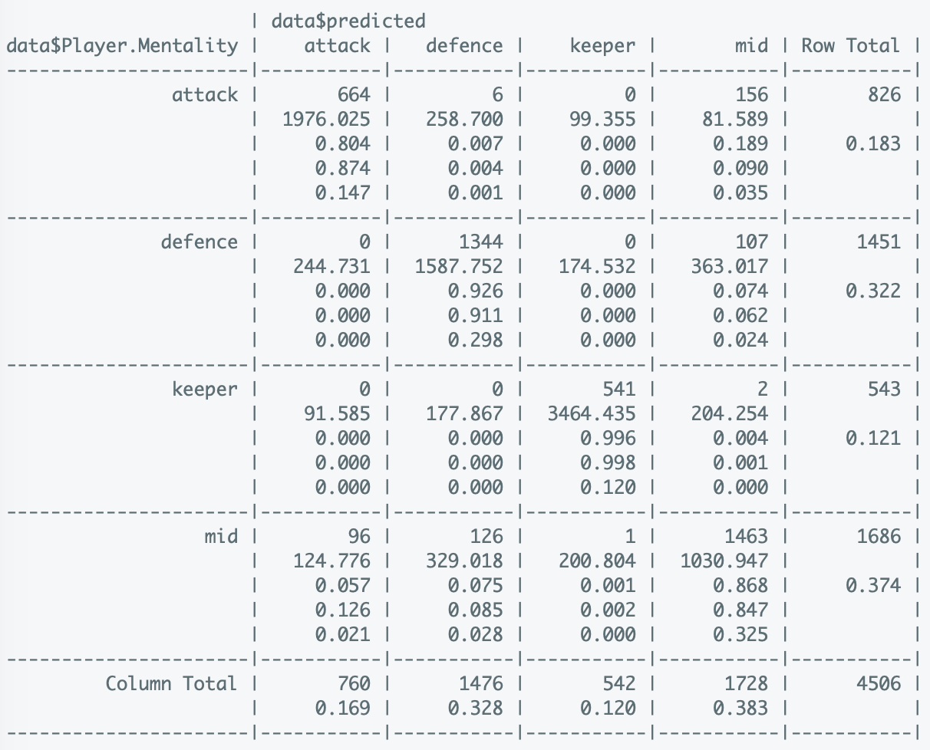
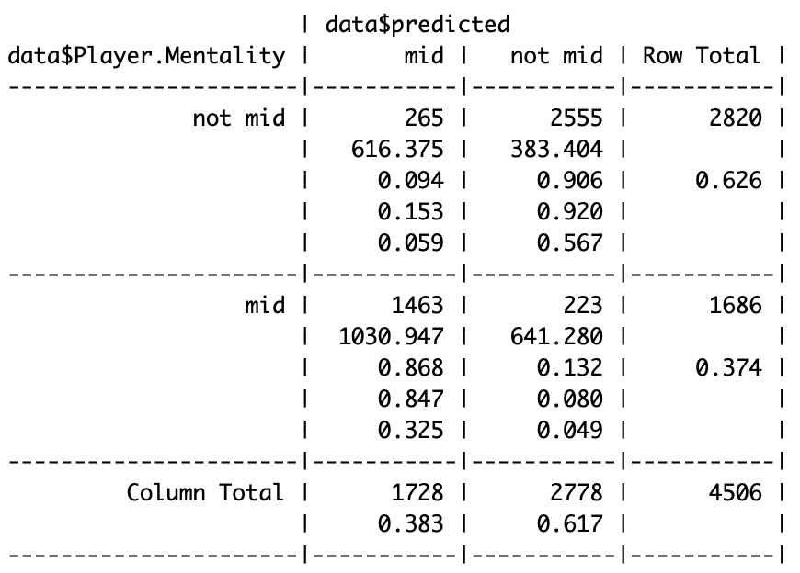
Test dataset: Actual vs. Predicted
Notes:
Lydia-
This is a Crosstable of our logistic regression results. Using this method, it’s easier to make comparisons to our KNN results. The greatest number of incorrect predictions are when we predicted mid and it is actually attack, or when we predicted defence, and it is actually mid. There’s also 96 times we predicted attack when it is actually mid. In all these cases, the errors all relate to the midfield position. So as expected, mid is the weakest predictor of logistic regression.

Slide 8
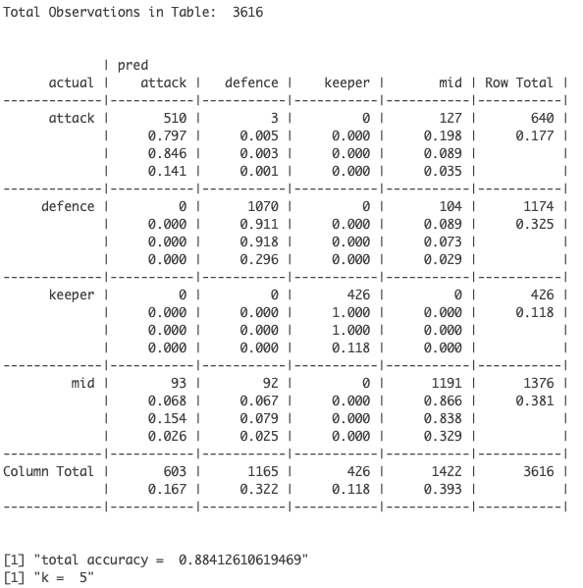
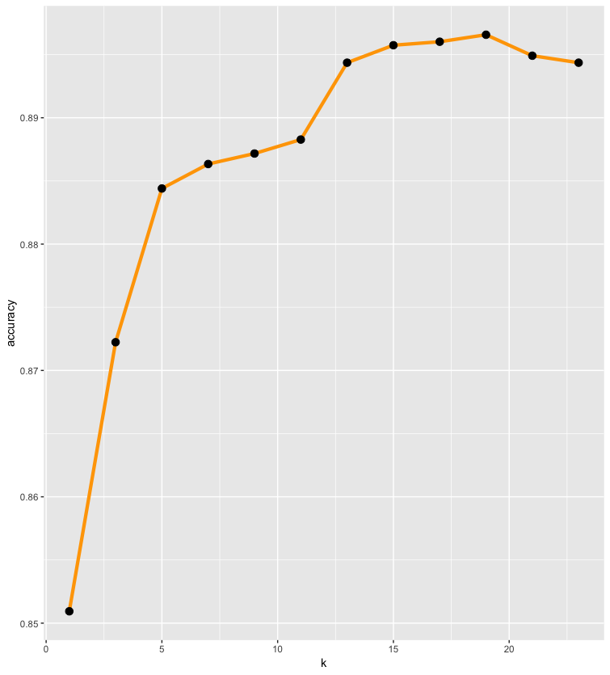
KNN - All Four Positions
Notes:
Best k : 5 with accuracy rate: 0.885
Choose the five nearest neighbors
Keep false negative as low as possible

Slide 9
Conclusion
Choose KNN with k = 5
With the specific given k of 5, the algorithm can produce the result with accuracy of around 88.4%
Notes:
We’ve decided to select the KNN with k=5 as the more reliable classification method over the slightly more accurate logistic regression model. KNN allows us to classify data points based on feature similarity for groups, which fits our data, where we hope to group based on player position. Also, as KNN is a learning algorithm, we find this to be more robust than a more rigid logistic regression model. To re-summarize our process, we began by using KNN for the individual player positions. Then we proceeded to individual logistic regression, a recursively applied logistic regression, then finally a complete KNN for predicting 4 class labels at once.
For comparison purposes, we turned to logistic regression modeling, but realized that predicting one class label against three others greatly skewed our data. In the case where we predicted goalkeeper or other, there were only approximately 2,000 out of 17,000 players for a goalkeeper position. Accordingly, the results of the logistic regression modeling we found are not dependable. To address this problem, we recursively ran logistic regression and feature selection. After splitting our data into a training and testing dataset, we performed feature selection and created a logistic model using the training dataset, before predicting goalkeeper or ‘other’ from the testing dataset. Then taking a subset of the observations found to be ‘other’, we use that as a new training dataset to perform feature selection and create another logistic model, before predicting defence or ‘other’ from the testing dataset. After one more iteration of feature selection and logistic regression modeling for attack or ‘mid’, we can compare the predicted results with the actual player positions of the testing set. The accuracy we received for this type of recursive logistic regression model is approximately 89%.

Slide 10
References
Lao, D. (2018, July 27). FIFA 18 - Predict Player’s Positions. Retrieved October 20, 2018 from https://www.kaggle.com/laowingkin/fifa-18-predict-player-s-positions
Razali, N. , Mustapha, A., Ahmad Yatim, F. & Ab Aziz, R. (2017, August). Predicting Player Position for Talent Identification in Association Football. IOP Conference Series: Materials Science and Engineering. 226. 012087. 10.1088/1757-899X/226/1/012087.
Data set: https://www.kaggle.com/thec03u5/fifa-18-demo-player-dataset

Slide 11
Thank You

